Slide 1



Machine Learning
Lecture 10: Decision Trees
Instructor: Dr. Shazia Saqib

Slide 2

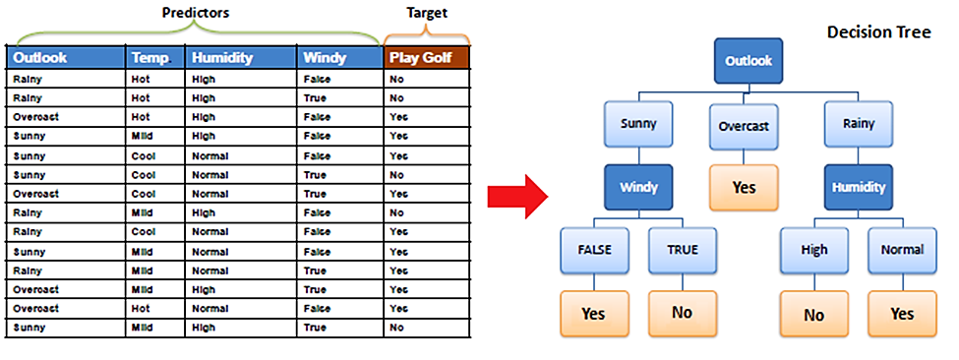

Slide 3
Parametric Machine Learning Models
Nonparametric models are models that do not assume a fixed number of parameters. Instead, they allow the number of parameters to grow with the amount of training data(KNN, DT..).
Parametric models are those that assume a specific form or structure for the function that maps inputs to outputs, and they have a fixed number of parameters, regardless of the size of the dataset(Linear regression, Logistic Regression).

Slide 4

Entropy
In machine learning, entropy is a measure of the randomness in the information being processed. The higher the entropy, the harder it is to draw any conclusions from that information.
Entropy is a metric to measure the impurity in a given attribute. It specifies randomness in data.
Entropy comes from information theory. The higher the entropy the more the information content.

Slide 5

Information Grain
Information gain can be defined as the amount of information gained about a random variable or signal from observing another random variable. It can be considered as the difference between the entropy of parent node and weighted average entropy of child nodes.
IG(S, A) = H(S) - H(S, A)
Alternatively,

Slide 6
Decision Trees(ID3 or Cart)
Organizes decision rules in hierarchical tree structure
Goal: Predict target values by learning rules from training data
Advantages: Easy to interpret, good for visualization

Slide 7
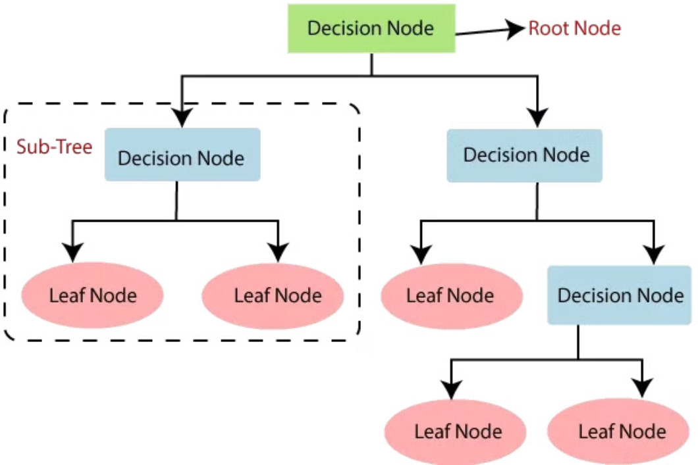
Decision Tree Terminology
1
Root Node
2
Splitting
Beginning of tree (entire population)
Dividing nodes into sub-nodes
3
Decision Node
4
Leaf/Terminal Node
Sub-node that can be further split
Final node with no further splits
5
Pruning
Removing sub-nodes to prevent overfitting (opposite of splitting)

Slide 8
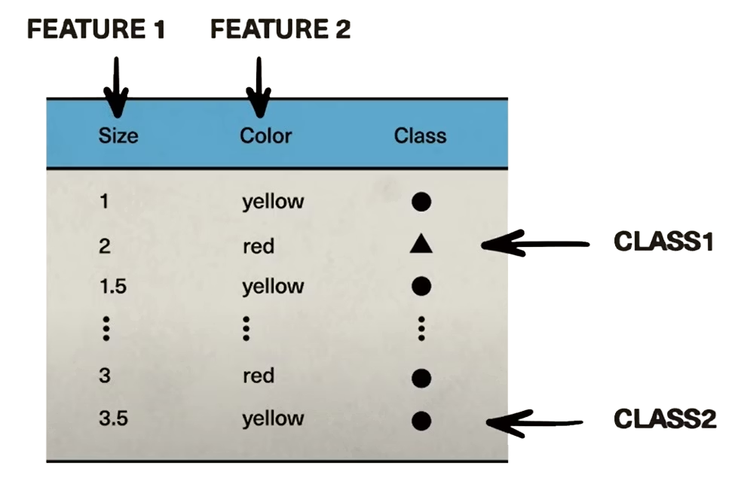
Building a Decision Tree
Inspecting the Dataset
Example with:
Features: Size (1.5, 2.5, 3.5), Color (yellow/red)
Classes: Class1, Class2

Slide 9
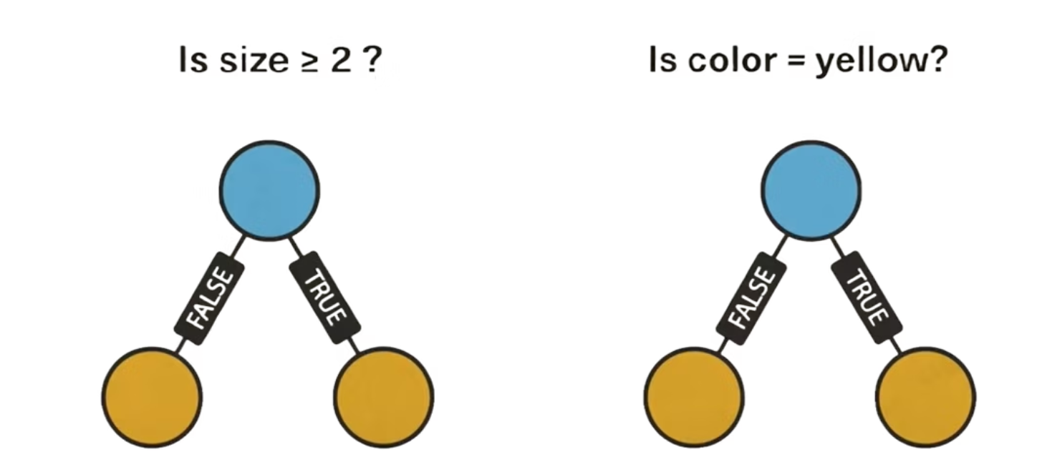
Potential Decision Rules for Building a Decision Tree
Is size ≥ 2?
Is color yellow?

Slide 10

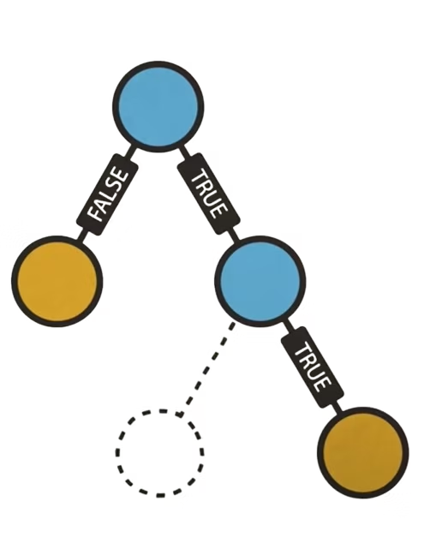

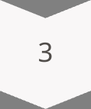
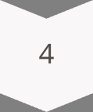
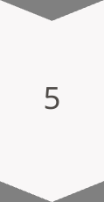
Tree Construction Process
Start at root node
Evaluate all possible splits
Choose split with highest Information Gain
Recursively split child nodes
Stop when:
No more decision rules available
Node impurity reaches zero
Pruning/early stop conditions met

Slide 11
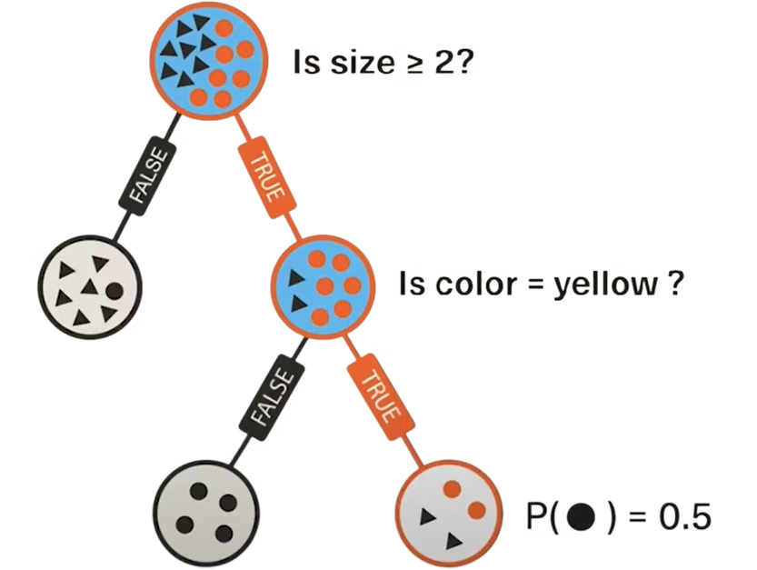
Making Predictions
1
Input new data point
Features of unseen example
2
Traverse tree
Follow decision rules based on features
3
Reach leaf node
Shows class probabilities
4
Make prediction
Example: Size ≥2 AND color yellow → 50% chance of being Class1

Slide 12
Advantages & Limitations
Advantages:
Limitations:
Intuitive interpretation
Prone to overfitting (especially deep trees)
Handles both numerical/categorical data
Can be unstable with small data changes
Minimal data preparation needed

Slide 13
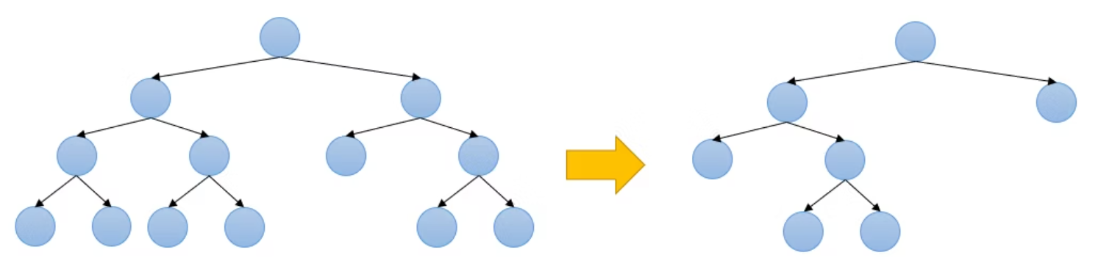
Overfitting in Decision Trees
Definition
Consequences
Overfitting occurs when a tree becomes too complex, memorizing noise/outliers in training data instead of learning general patterns.
Poor performance on unseen data (low
generalization).
"Deep" trees with unnecessary splits
(e.g., one leaf per sample).
A model that fits training data perfectly may fail in the real world.

Slide 14
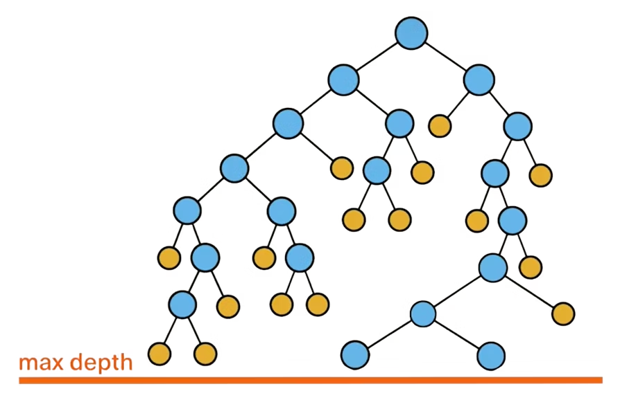
Overcoming Overfitting: Max Depth
1. Max Depth Limitation
How it works: Restricts tree depth (e.g., max 5 levels).
Limit tree depth to balance bias-variance
Pros
Reduces overfitting by simplifying the tree.
Cons
Increases bias (may underfit complex patterns).

Slide 15
Summary & Conclusion
Decision Rules
Optimal Splits
Decision trees organize hierarchical decision rules
Information Gain guides optimal splits
Node Purity
Advanced Methods
Gini Impurity measures node purity
Random Forests address overfitting concerns
Decision trees are a powerful yet interpretable modeling technique.

